Slide 1
RootKit and windows Internal

Slide 2
Topics
Windows Internal.
Windows architecture
From User space to Kernel space.
SSDT
Demo
Kernel Callback functions
Demo.
Windows driver
Demo ☺

Slide 3
Windows Internal
User space (ring 3)
Kernel Space (ring 0)
Windows build a block of virtual address for user applications.
A block of virtual address that stored the kernel code (core of the operating system).
Processes have access only to this block.
The kernel code have access to user space as well.
Processes does not have to worry about Memory management or paging, nor about putting hardware in an invalid state for another process.
The kernel code deal with memory management, hardware and IO….
Processes crashing usually will not crash the system.

Slide 4
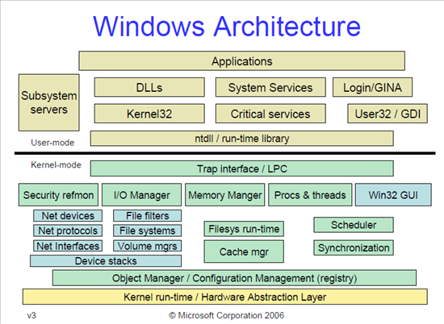
Windows Architecture
Layered design that consists of two main components, user mode and kernel mode

Slide 5
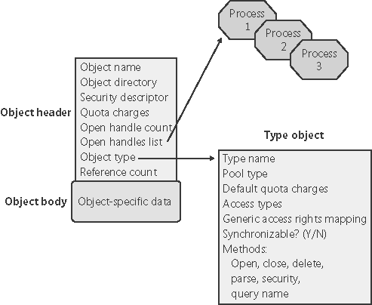
Windows Architecture Object Manager
Object Manager is the centralized resource broker in the Windows NT line of operating systems, which keeps track of the resources allocated to processes.
Each object has a header (containing information about the object such as its name, type, and location), and a body (containing data in a format determined by each type of object).
Object Ex: Process, Thread, Job, File, Access token, Pipe, Symbolic link, Driver, Device, or file

Slide 6
Windows Architecture Object permission
Each Object have a Security Descriptors structure which defined their permissions.
Security descriptors contain discretionary access control lists (DACLs) that contain access control entries (ACEs) that grant and deny access to trustees such as users or groups.
typedef struct _SECURITY_DESCRIPTOR {
BYTE Revision;
BYTE Sbz1;
SECURITY_DESCRIPTOR_CONTROL Control;
PSID Owner;
PSID Group;
PACL Sacl;
PACL Dacl;
} SECURITY_DESCRIPTOR, *PISECURITY_DESCRIPTOR;

Slide 7
User space to kernel space

Slide 8
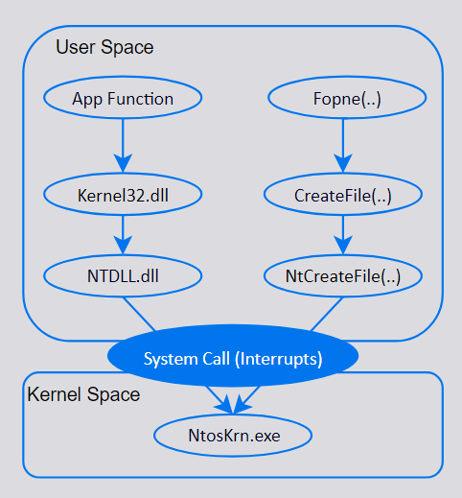
Windows API layers

Slide 9
System Calls (interrupts) System Service Dispatch Table
System calls in Windows are used for file system control, process control, interprocess communication, main memory management, I/O device handling, security etc.
Switch the execution flow from user to kernel space.
Hardware interrupt to get OS immediately support.
Exceptions: page faults, illegal instructions, IOException ….
KiSystemService contain the address of the system function addresses table.
System call will raise the interrupt 0x2E that executes the SSD.

Slide 10
System Service Dispatch Table
User Application
User space
System Call (Interrupts)
Kernel space
KiServiceTable
Ntoskrnl!NtCreateFile

Slide 11
Demo

Slide 12
Callback function
The callback mechanism provides a general way to request and provide notification when certain events occurred.
Every callback object has a name and a set of attributes, defined when the object is created.
System-Defined callback:
New process
Register access/create
….
Callback functions provided by drivers.
User level callback.

Slide 13

kernel addresses of callback functions
nt!PspCreateProcessNotifyRoutine array of create/terminiated process callback.
nt!PspCreateThreadNotifyRoutine array of create/terminiated Thread callback.
nt!PspLoadImageNotifyRoutine array of image load callbacks.
Notes!
Not exported by ntoskrnl.exe.
Indirect way to catch them in memory.
These addresses point to _EX_CALLBACK_ROUTINE_BLOCK (undocumented structure, thanks to ReactOS).

Slide 14
Windows Memory
Base Address
ASLR
Offset
Address of function
Address of the first byte of image when loaded into memory.
Randomly arranges the address space of objects (not applicable for some objects).
The offset between functions are fix, add_func – base address = offset.
By calculate the offset we can get the address of the functions.
Func_ add = func_offset + base address
Our target..
Windows kernel in memory (ntoskrnl.exe), So play with it!
Load ntoskrnl.exe with DONT_RESOLVE_DLL_REFERENCES
Get any function address GetProcAddress
Add_func – loaded kernl base address = func_offset
Get the base address of ntoskrnl (GetDeviceDriverBaseNameA)
Func_offset + base addres of ntoskrnl in memory = function address in memory.

Slide 15
Demo

Slide 16
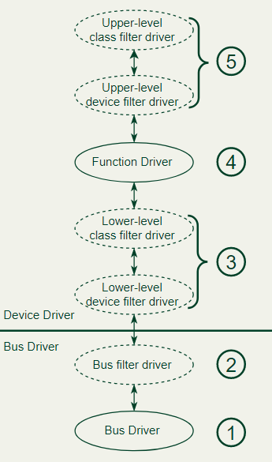
Windows driver
Types of WDM (Windows Driver Model) drivers:
Bus driver
Function driver
Filter driver
A bus driver drives an individual I/O bus device and provides per-slot functionality that is device-independent. Bus drivers also detect and report child devices that are connected to the bus.
A filter driver filters I/O requests for a device, a class of devices, or a bus.
A function driver drives an individual device.

Slide 17
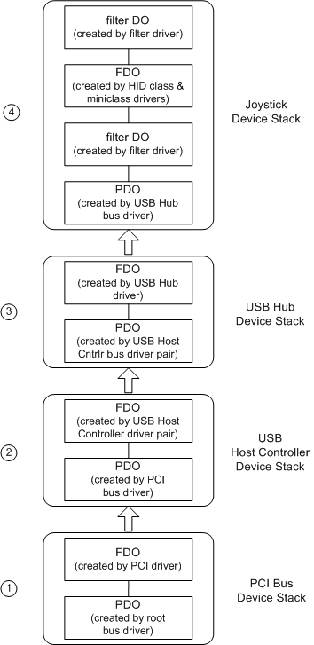
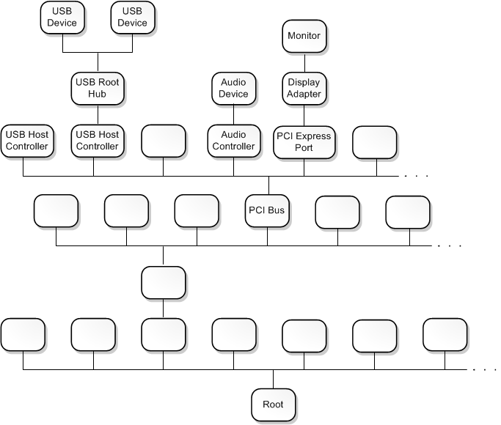
Windows Drivers
Driver stacks
The sequence of device objects along with their associated drivers is called a device stack. Each device node has its own device stack.
The device stack must have one (and only one) function driver and can optionally have one or more filter drivers.

Slide 18
Windows Drivers
Filter driver (kernel filter or mini-filter)
Minifilter drivers attach in a particular order.
Altitude ensure the instance of the minifilter driver is always loaded at the appropriate location.
The mini-filter intercepts requests before reaches its intended drivers, which can extend or replace functionality provided by original drivers.
Anti-virus filters
Backup agents
Encryption products
FltRegisterFilter and FltStartFiltering for File System mini-filter.
NdisFRegisterFilterDriver for network mini-filter.

Slide 19
Demo

Slide 20
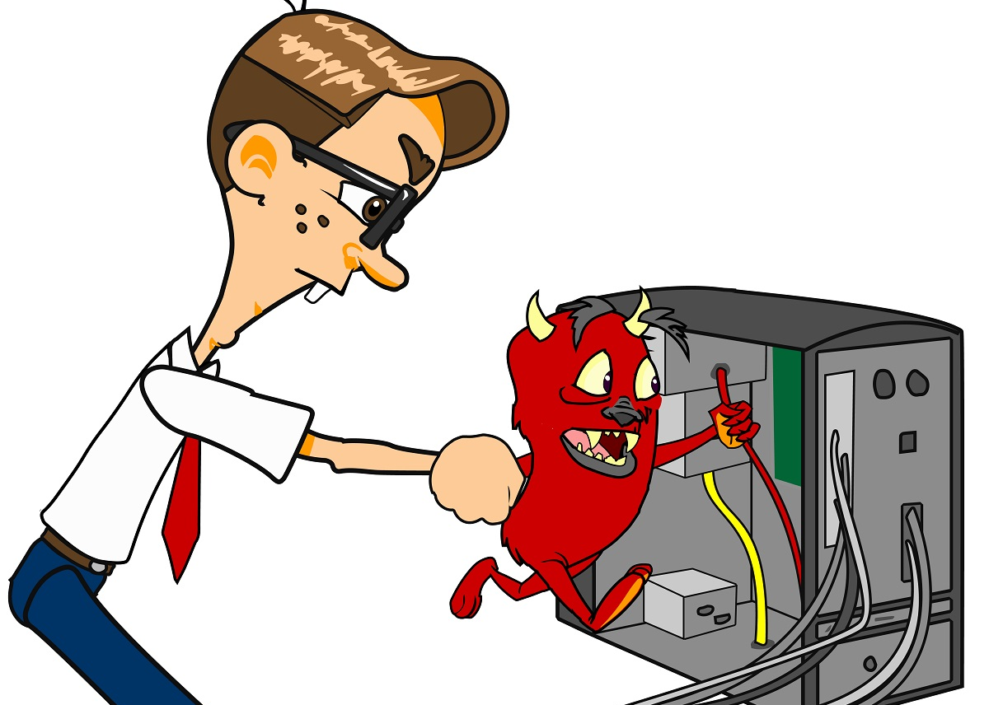
Thank you !!!

